Slide 1
Relational Network Analysis For a Popular Novel
The miserable: is a French historical novel by Victor Hugo, first published in 1862, that is considered one of the greatest novels of the 19th century. Les Misérables has been popularized through numerous adaptations for film, television and the stage, including a musical.

Slide 2
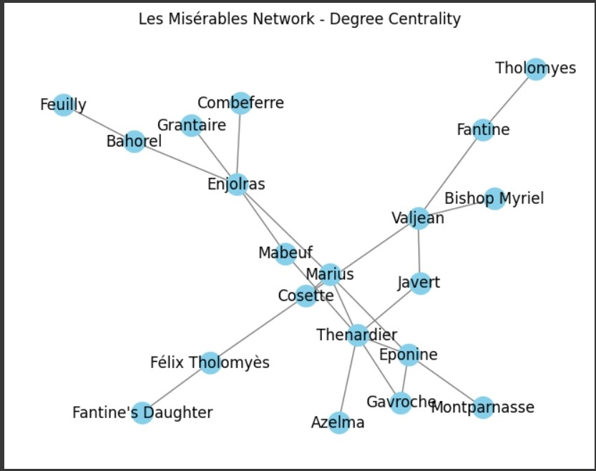

Slide 3
Explanation:
Number of edges: 23
Number of nodes: 20
# Add characters as nodes
characters = [
"Valjean", "Fantine", "Cosette", "Marius", "Eponine", "Javert", "Thenardier",
"Gavroche", "Enjolras", "Mabeuf", "Bishop Myriel", "Tholomyes", "Grantaire",
"Félix Tholomyès", "Azelma", "Montparnasse", "Bahorel", "Combeferre", "Feuilly"
]

Slide 4
Top 5 characters by degree centrality:
Thenardier 0.3157894736842105
Enjolras 0.2631578947368421
Valjean 0.21052631578947367
Marius 0.21052631578947367
Eponine 0.21052631578947367

Slide 5
Degree Centrality
Degree centrality: The degree centrality of a node is the fraction of nodes it is connected to.
In the code, the degree centrality variable is calculated using the nx.degree_centrality(network) function. It returns a dictionary where the keys are characters and the values are their degree centrality scores. The dictionary is then sorted in descending order based on the centrality scores using sorted() and reverse=True

Slide 6
Closeness
Closeness centrality: The closeness centrality of a node is the average length of the shortest paths between the node and all other nodes in the network.
Int the code, The closeness centrality variable is calculated using the nx.closeness_centrality(network) function, which returns a dictionary of closeness centrality scores for each character. Similarly, the dictionary is sorted in descending order.

Slide 7
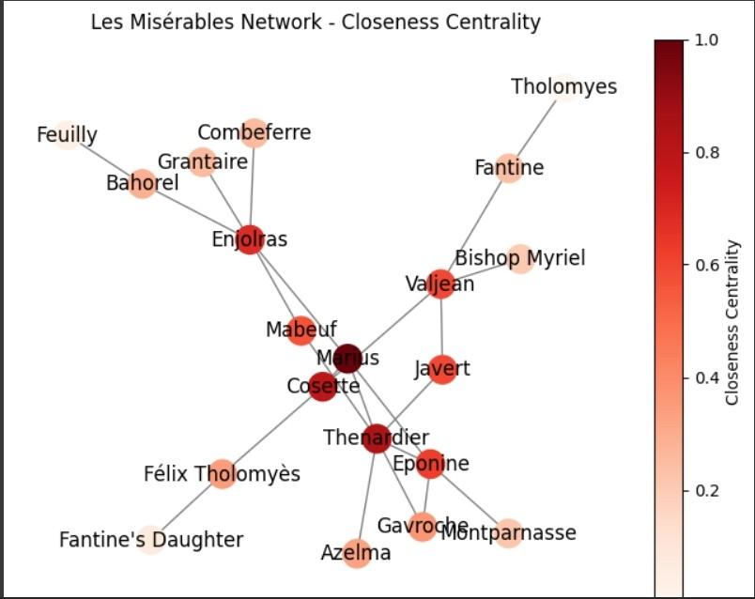

Slide 8
Betweenness
Betweenness centrality: The betweenness centrality of a node measures the extent to which a node lies on the shortest paths between other nodes.
In the code, The betweenness centrality variable is calculated using the nx.betweenness_centrality(network) function, which returns a dictionary of betweenness centrality scores for each character. Again, the dictionary is sorted in descending order.

Slide 9
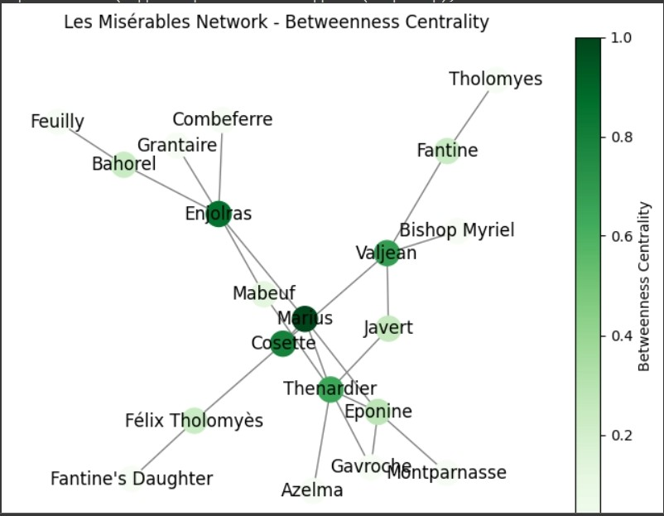

Slide 10
Eigenvector centrality
Eigenvector centrality: The eigenvector centrality of a node measures the influence of a node in the network, taking into account the centrality of its neighbors. The eigenvector_centrality variable is calculated using the nx.eigenvector_centrality(network) function, which returns a dictionary of eigenvector centrality scores for each character. The dictionary is sorted in descending order.

Slide 11
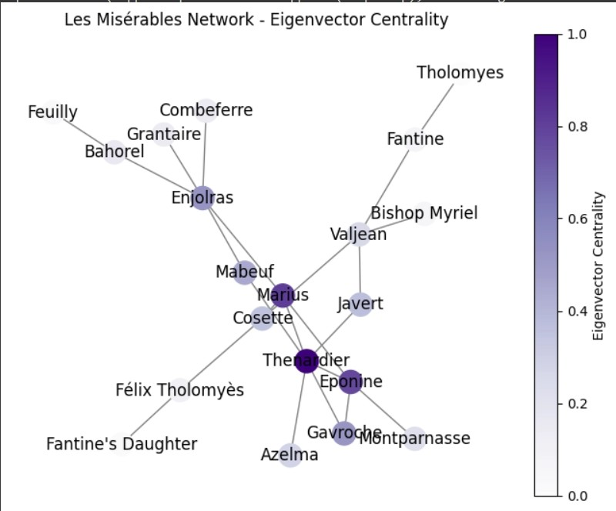

Slide 12
Triadic closure
Triadic closure is a specific type of clustering where two nodes that are connected to a common neighbor have a higher likelihood of being connected to each other as well.
In the code you provided, the line strong_triadic_closure = intransitivity(network) calculates the transitivity of the network using the transitivity() function provided by the NetworkX library. The transitivity value represents the ratio of the number of closed triads (i.e., triangles) to the total number of triads in the network.

Slide 13
end
Made by:
Mohammad Sweilmeen
Abdulrhman Hannini
Osama Sardi

